Slide 1
TCP/IP Model

Slide 2
Introduction
The TCP/IP Model, also known as the Internet protocol suite, was developed in 1989.
Its development was funded by DARPA (Advanced Research Projects Agency (ARPA) was renamed to the Defense Advanced Research Projects Agency (DARPA)!)
Its technical specifications are detailed in RFC 1122.
This model is primarily based upon the most protocols of the Internet, namely the Internet Protocol (IP) and the Transmission Control Protocol (TCP).

Slide 3
The Layers of the TCPIP Stack
The TCP/IP model splits up a communication system into 5 abstract layers, stacked upon each other.
Each layer performs a particular service and communicates with the layers above and below itself.

Slide 4
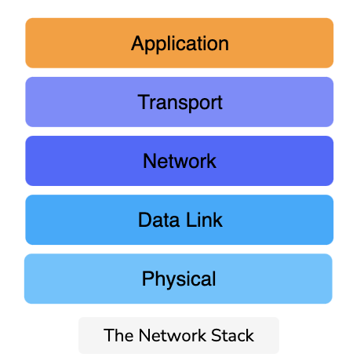
The Layers of the TCPIP Stack
Here are the five layers of the TCP/IP model:

Slide 5
TCP/IP vs OSI
Here are some main differences between TCP/IP and OSI.
TCP/IP | OSI
Is used practically | The OSI model is conceptual and is not practically used for communication.
Consists of five layers | Consists of seven layers

Slide 6
TCP/IP vs OSI
Elaborating further on the first point, OSI is a theoretical model and works very well for teaching purposes, but it’s far too complex for anyone to implement.
TCP/IP, on the other hand, wasn’t really a model. People just implemented it and got it to work. Then, people reverse-engineered a reference model out of it for theoretical purposes.

Slide 7
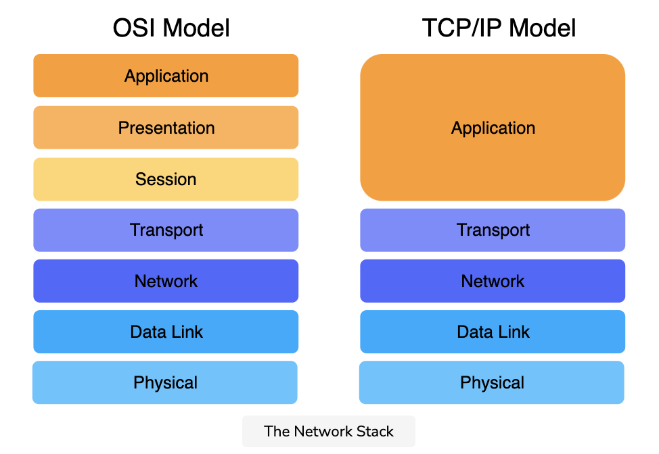
Differences in Layer Functionality
The layers in the TCP/IP stack largely perform the same functions as their counterparts in the OSI model.
The difference is that the application layer in the TCP/IP model encompasses the functionalities of the top three layers of the OSI model.

